Slide 1
Why Don’t We Complain William F. Buckley, Jr
Feb. 25th, 2022
Presenters: 许晶 孔荣昌 江隽源
Notes:
Good morning, I am glad to be here for the 2 time as the first presenter of a semester. But because we don’t have enough time to cover all the five aspects of presentation in this week, so the difficult sentence and the rhetorical devices will be introduced to you next week by our partner, 许晶。

Slide 2
1) About the Structure of this essay
It might be an argumentation supported by exemplification while some examples were in detail, some examples were just being touched upon.
Notes:
Genre of this essay.
The examples are not in the same length. We can refer to the text. Some examples cover many paragraphs, for instance, the first example, the experience on the train. Some examples only illustrated by few sentences.

Slide 3
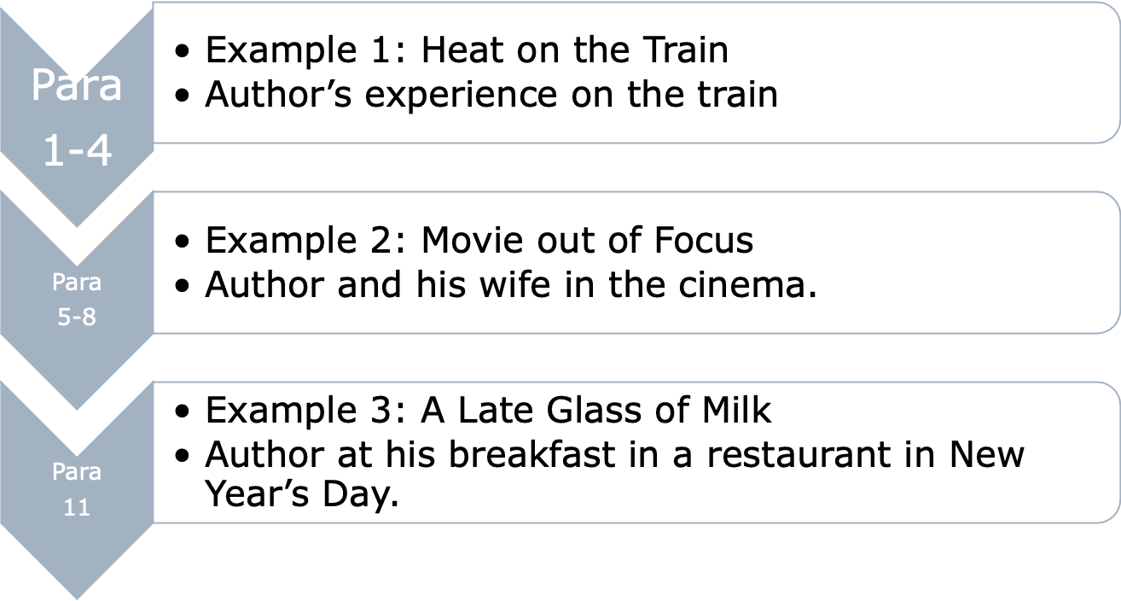
1) About the Structure of this essay

Slide 4
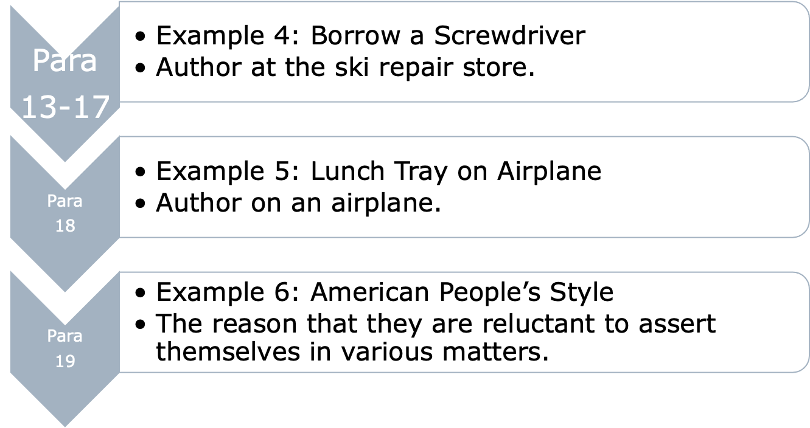
1) About the Structure of this essay

Slide 5
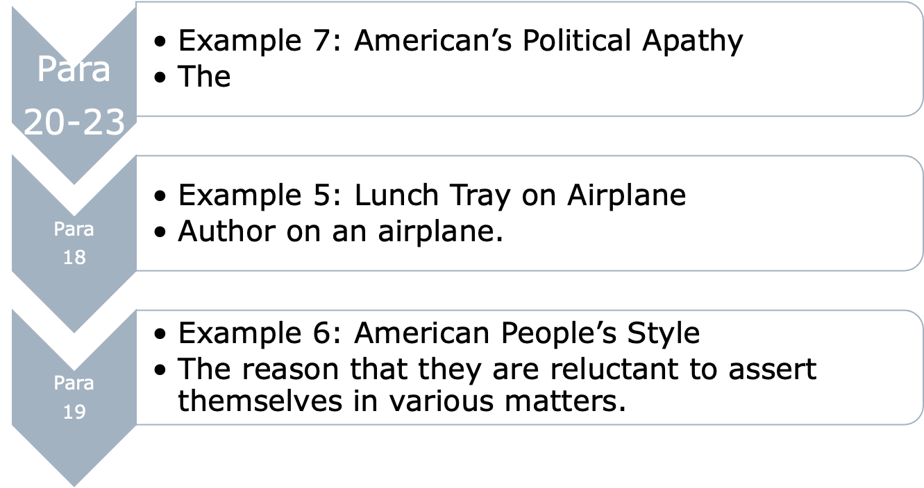
1) About the Structure of this essay

Slide 6
1) About the Structure of this essay
This essay can be divided into 8 parts in terms of content: example 1-7 and the final part, the conclusion.
Differently, in terms of narrative function, this essay can be divided into 2 parts, that is, examples and conclusion.

Slide 7
2) About the Theme of this essay
To criticized/ satirized American people’s unwillingness in asserting themselves (坚持自己的主张) in minor and grave matters.
That is, to criticized/ satirized American people’s unwillingness in bravely expressing their real thoughts and sticking to them in both big and small things.

Slide 8
3)Words and expressions
1. fleck(P1L5)… the car was flecked with the white shirts of passengers.
---- to mark with spots of color, light or the like; to speckle
e.g.
The bird’s breast is flecked with brown.
这只鸟的胸部有棕色斑点。
When a banana ripens it is flecked with brown.
当香蕉成熟时，会有棕色的斑点。

Slide 9
Words and expressions
2. virile (P2L2)
---- having or showing masculine spirit, strength, vigor, or power.
e.g.
His style of singing is very virile.
他演唱的风格浑厚有力。

Slide 10
Words and expressions
3. edge(P2L6)… with a considerable edge to my voice
---- sharpness; the quality of being sharp or keen
e.g.
Her remark has a biting edge to it.
她讲的话很尖刻。

Slide 11
Words and expressions
4. sibilant(P2L9)…to justify my sibilant intrusion into his stupor
---- hissing; having or making a hissing sound
e.g.
When he spoke, his voice was usually low and sibilant.
他说话时的声音老是低沉的、咝咝作响的。

Slide 12
Words and expressions
5. discreet(P2L10)…making a discreet fuss.
---- very careful in speech and action; showing good judgement; wisely cautious
e.g
A discreet person does not spread gossip.
智者不说闲话。

Slide 13
Words and expressions
6. set in(P2L2)
---- to begin
e.g.
Winter set in early.
冬天早早地降临了。
It seems to me you lived your life like a candle in the wind, never knowing who to cling to when the rain set in.
在我看来，你的生活就像风中的蜡烛，从不知道在雨中该依附谁。

Slide 14
Words and expressions
7. nonchalant(P3L1)…nonchalantly walked down the gauntlet
---- without warmth or enthusiasm; coolly unconcerned; casually indifferent; apathetic
e.g.
a nonchalant manner 无所谓的样子
a nonchalant reply 漫不经心的回答
She remained quite nonchalant during all the excitement.
在所有激动人心的事件中，她仍然相当淡定。

Slide 15
Words and expressions
8. gauntlet(P3L1)… nonchalantly walked down the gauntlet
---- n. a former military punishment. Here the conductor should have been consigned to this military punishment.
expression:
run the gauntlet
---- to be punished by means of the gauntlet; to proceed while under attack from both sides, as by criticism, gossip, etc.

Slide 16
Words and expressions
9. visualize(P4L1)
---- to form a mental picture of(something not present to the sight, an abstraction, etc.); envision
e.g.
to visualize a friend’s face when he is away
当朋友不在时，想象他的样子
to visualize the scene of a battle
想象一下战斗的场景

Slide 17
Words and expressions
10. apprehensively(P5L4)
---- feeling alarm; afraid, anxious or fearful about the future; uneasy, or worried
e.g
The captain felt apprehensive about the safety of his passengers during the storm at sea.
在海上的风暴中，船长对乘客的安全感到忧虑。

Slide 18
Words and expressions
11. irksome(P5L14)…calling dramatic attention to the irksome distortion
---- annoying; tiresome (SYN) wearisome
e.g
Washing dishes all day would be an irksome task.
Company was irksome to me.
去上班令我感到不快

Slide 19
Words and expressions
12. head-on(P8L6)…before undertaking a head-on…
---- a crash with the head or front first; in a direct manner; headlong
e.g
His car was involved in a head-on collision.
他的车被卷入迎面而来的碰撞。
It collided head-on with a truck.
它与一辆卡车迎头相撞。

Slide 20
Words and expressions
13. gird(P9L9) I am girded for a total showdown.
---- to get ready for action; to prepare (oneself) for action
e.g
to gird oneself to face an examination
The soldiers girded themselves for battle.
严阵以待

Slide 21
Words and expressions
14. fortify(P11L4)… I was fortified in my resolve
---- to give support to; strengthen physically, emotionally, etc.
e.g
They fortified each other against the coming ordeal.
他们互相支撑着对方，以应对即将到来的磨难。

Slide 22
Words and expressions
15. telltale(P13L8)…My pulse began its telltale acceleration.
---- showing, signaling, or warning of something; revealing, revelatory, suggestive, meaningful, significant, indicative
e.g
the telltale mud on his shoes
鞋子上明显的泥巴痕迹
Careful examination will reveal the telltale nits attached to the hairs.
仔细检查会发现附着在毛发上的明显的虱子。

Slide 23
Words and expressions
16. rare(P13L12)…six good men who were raring to ski
---- [Colloq.] to be eager, enthusiastic, etc.
e.g
raring to go 蓄势待发

Slide 24
Words and expressions
17. mortification(P16L2)
---- a feeling of shame; humiliation; chagrin; loss of self-respect (SYN) embarrassment
e.g
mortification at having spilled food on the tablecloth
饭菜洒在桌布上而感到羞愧
There’s no virtue in any mortification, either of the flesh or the spirit.
无论是肉体还是精神，在任何道德上都没有美德。

Slide 25
Words and expressions
18. unctuous(P18L9)…she spoke unctuously into the loud-speaker
---- too smoothly and oily; too suave or oily in speech or manner 圆滑，油嘴滑舌
e.g
the unctuous manner 虚伪的态度
an offensively unctuous speech 卑鄙无耻的言论

Slide 26
Words and expressions
19. prime(P22L4)… late in 1959 he was primed
---- to equip (a person) with information, words, arguments, etc.
e.g
to prime a person with a speech
以演讲的方式给人打气

Slide 27
Thank you!
Difficult Sentences and Rhetorical Device will be presented next week.

